Slide 1
Amazon Redshift

Slide 2
Reference:
Amazon Redshift tutorial. https://www.youtube.com/watch?v=7bfOllAyxlg
Getting Start with Amazon Redshift. https://www.youtube.com/watch?v=dfo4J5ZhlKI
Amazon document. https://docs.aws.amazon.com/redshift/latest/mgmt/overview.html

Slide 3
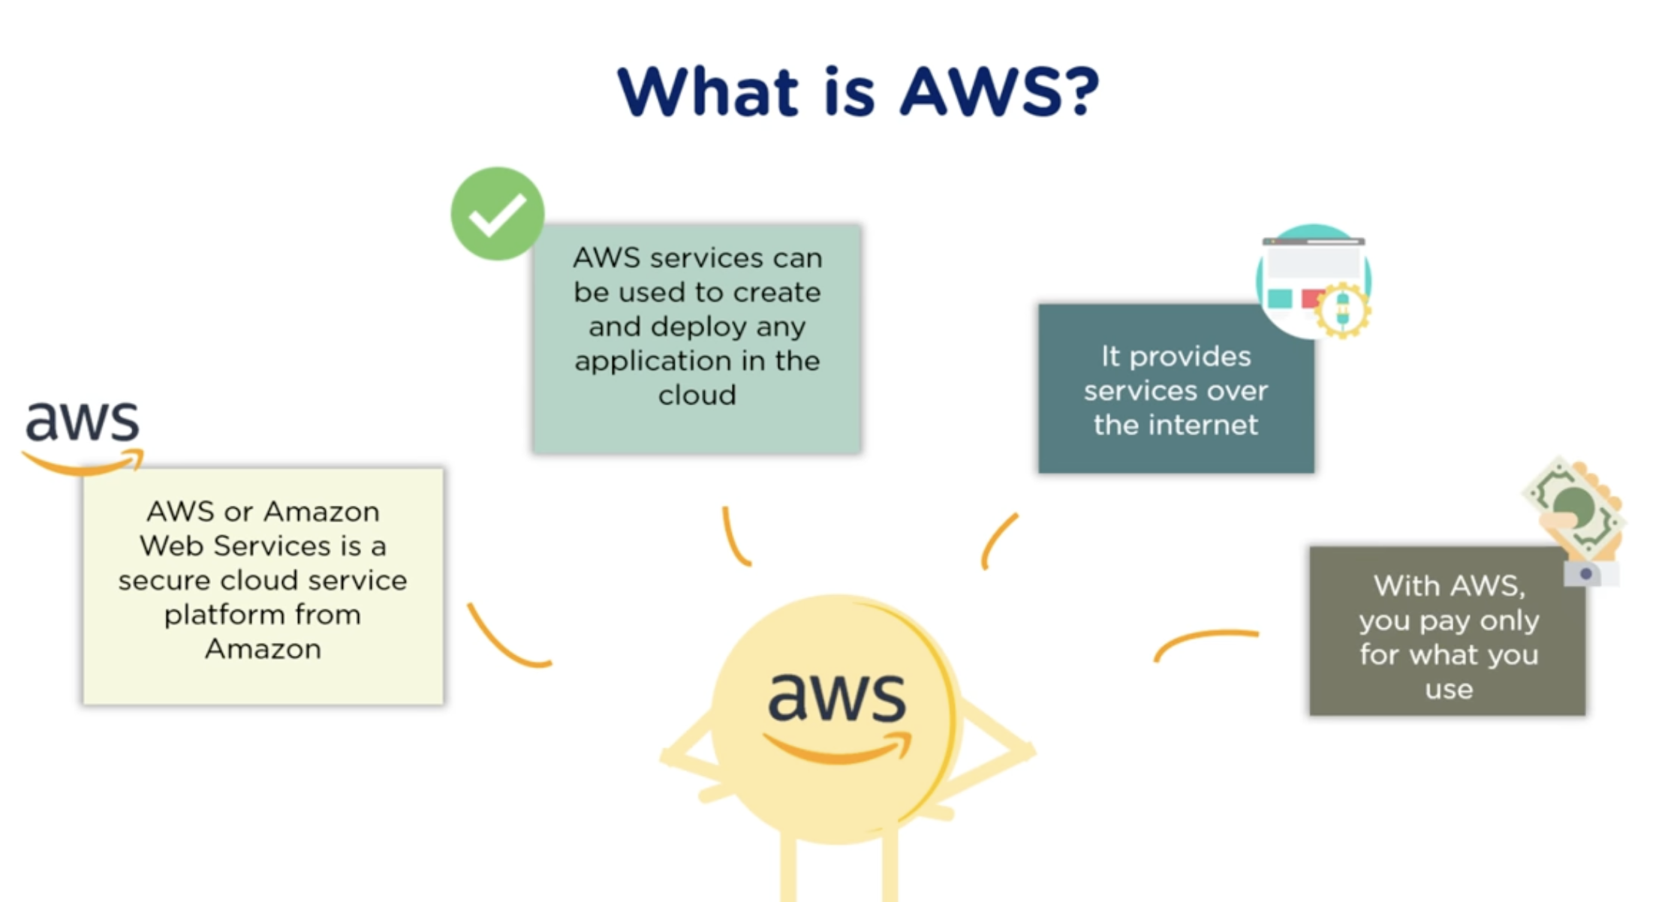
0. Inntroduction - What is AWS

Slide 4
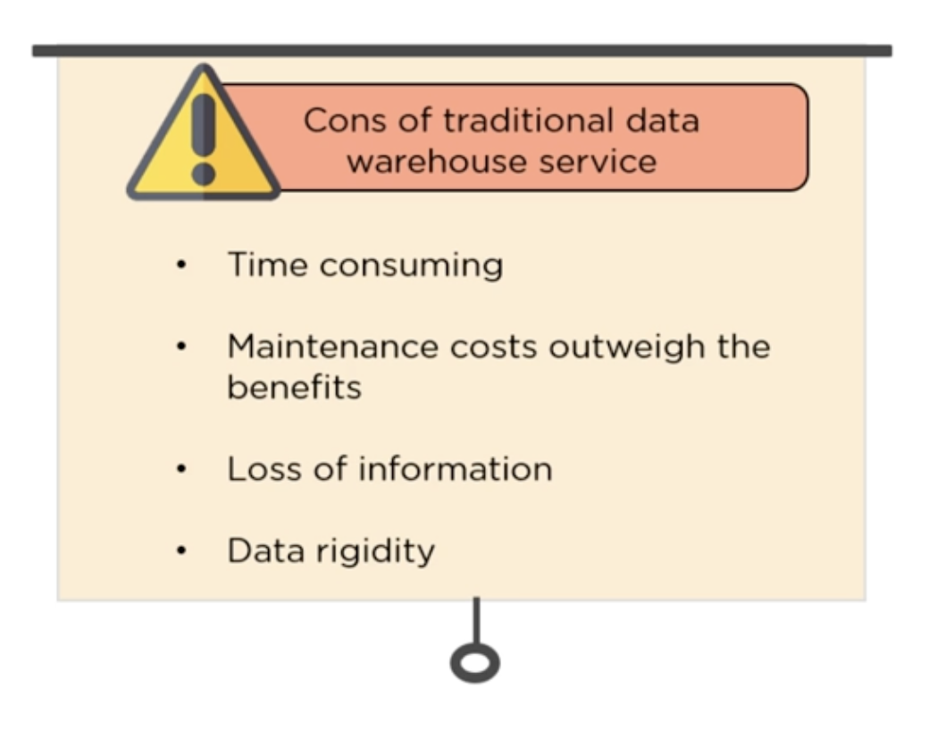
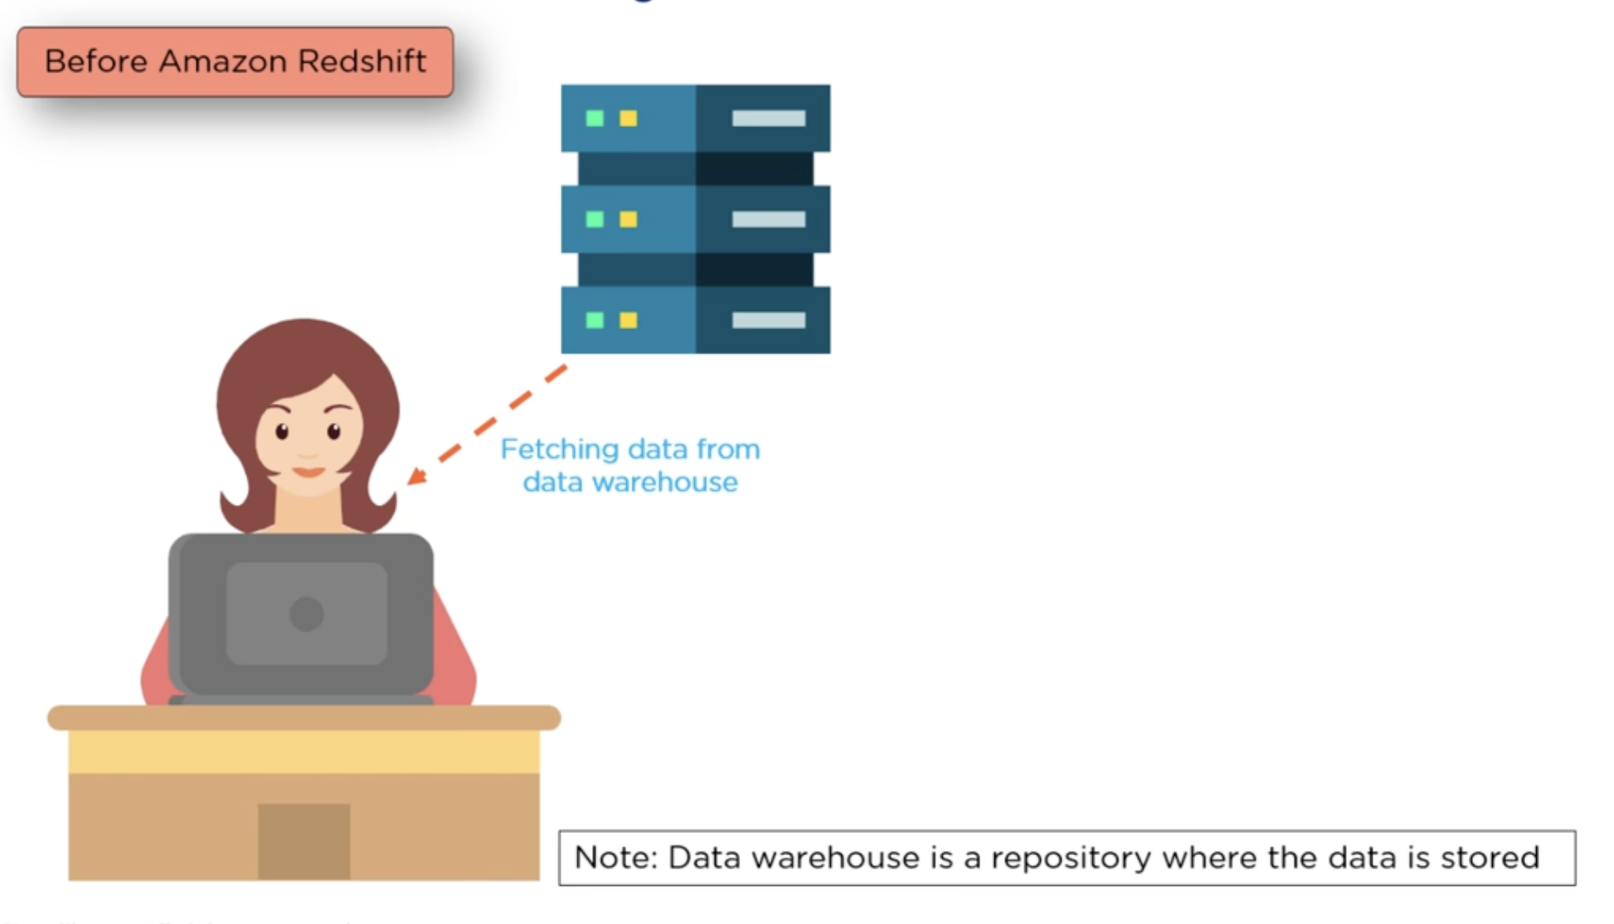
0. Inntroduction – Why use AWS

Slide 5
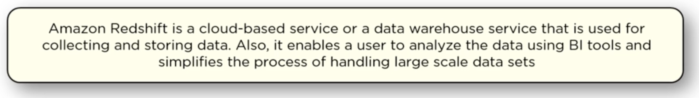
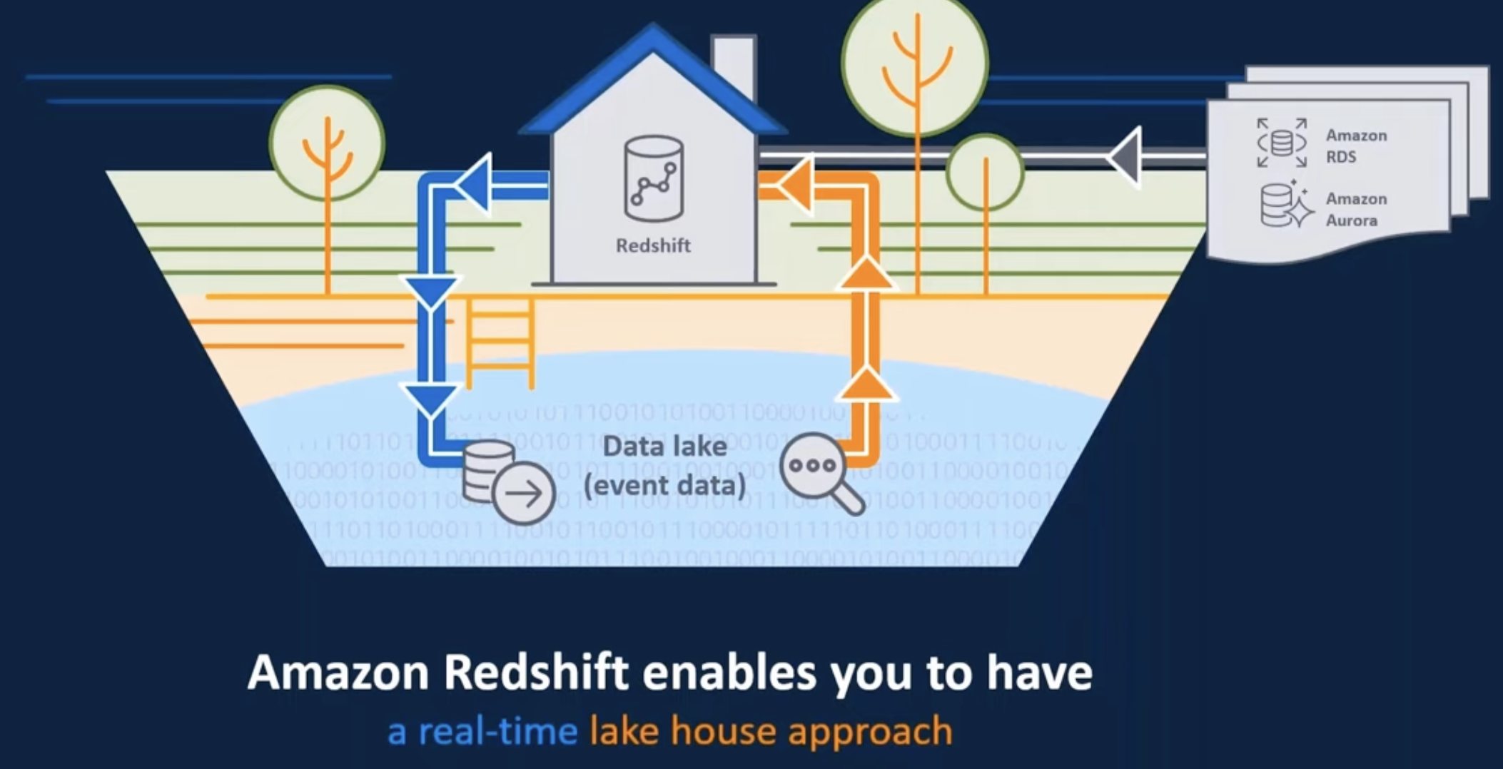
0. Inntroduction – Amazon Redshift
The Amazon Redshift service manages all of the work of setting up, operating, and scaling a data warehouse. These tasks include provisioning capacity, monitoring and backing up the cluster, and applying patches and upgrades to the Amazon Redshift engine.

Slide 6
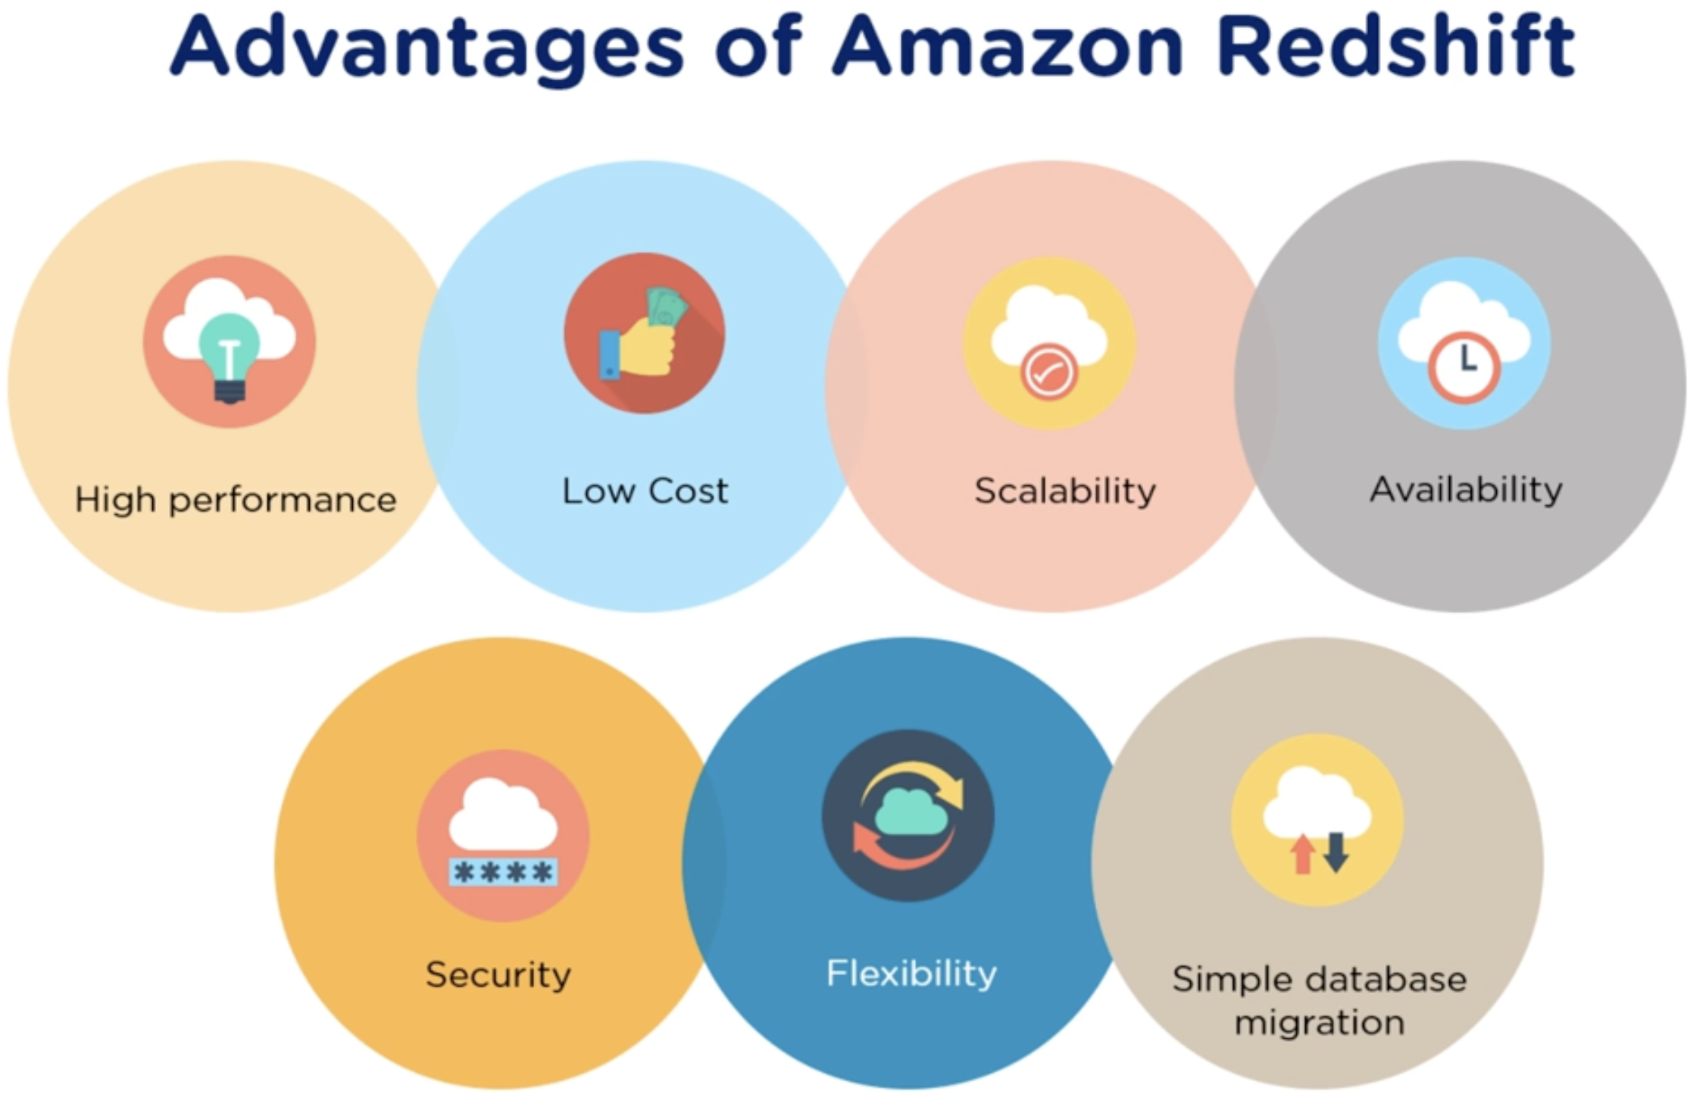
0. Inntroduction – Amazon Redshift- Advantages

Slide 7
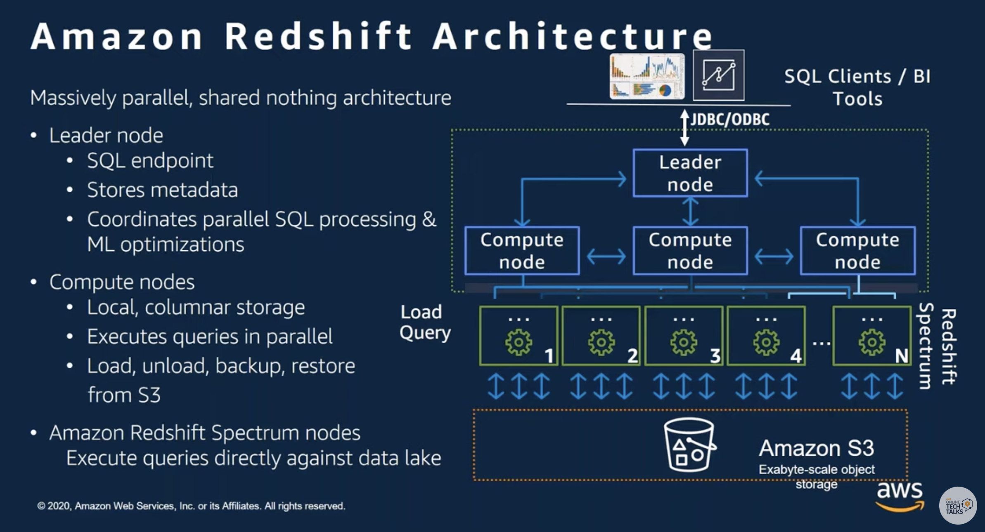
0. Inntroduction – Amazon Redshift- Architecture

Slide 8
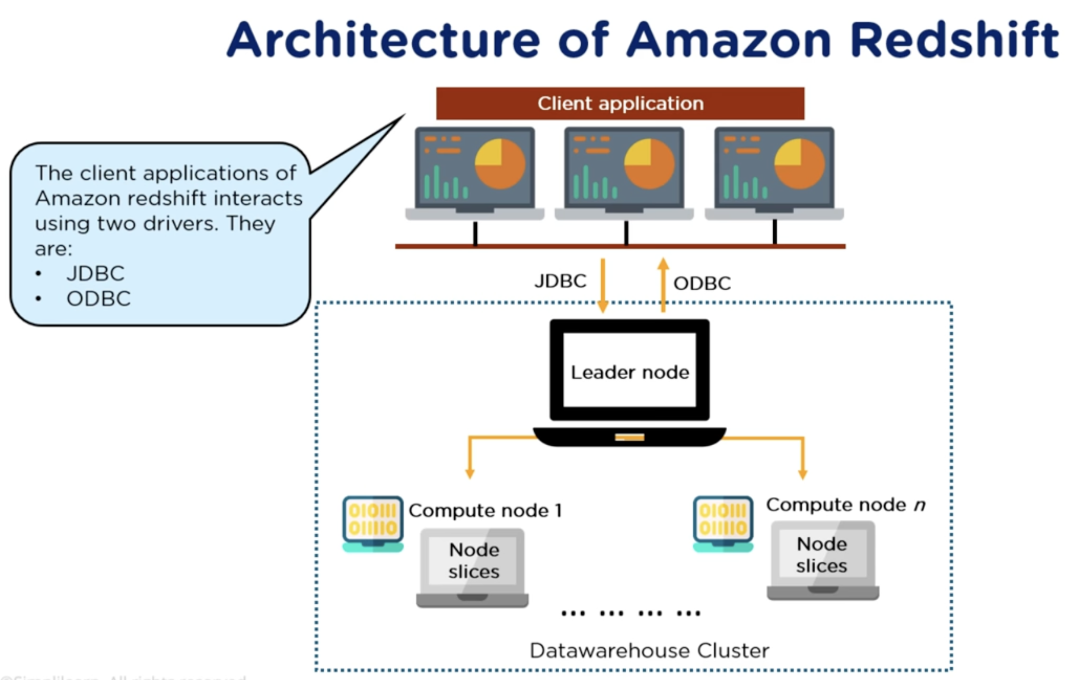
0. Inntroduction – Amazon Redshift – Architecture - Client application

Slide 9
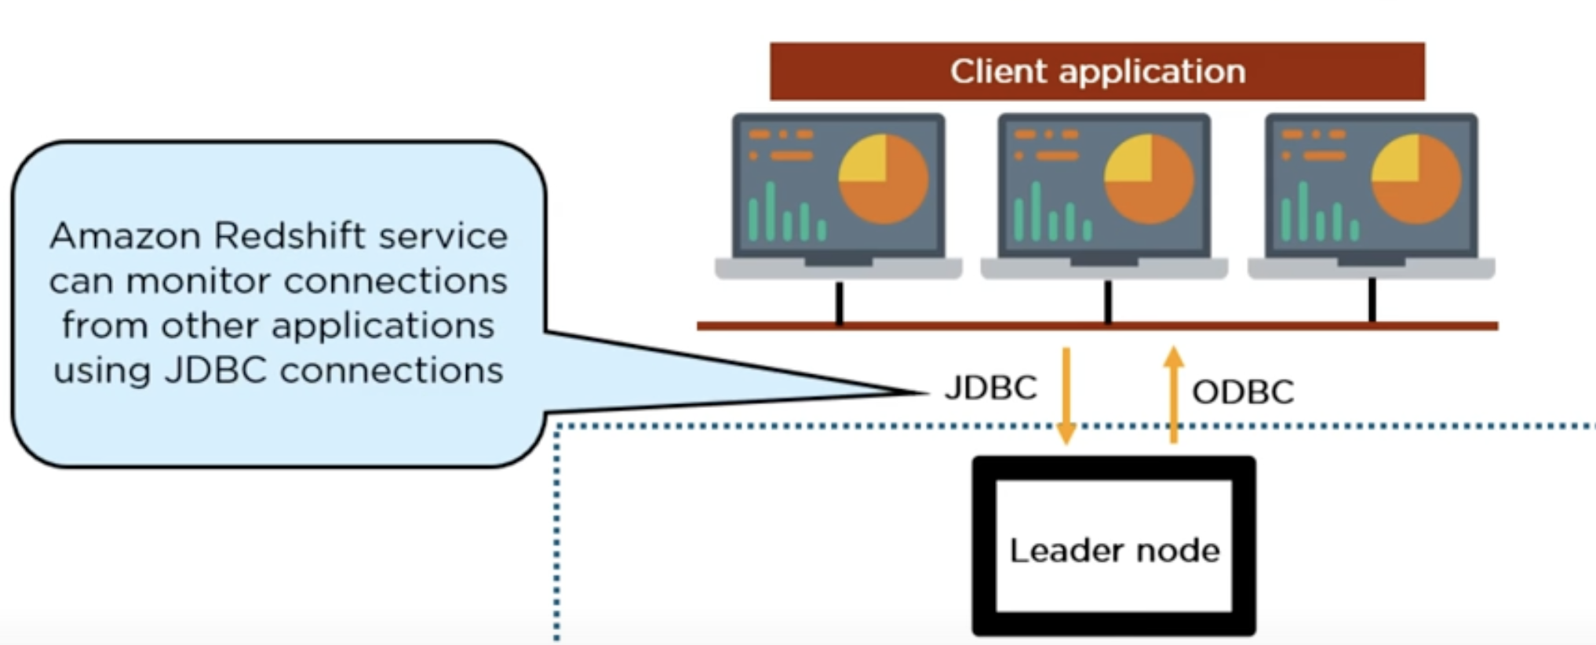
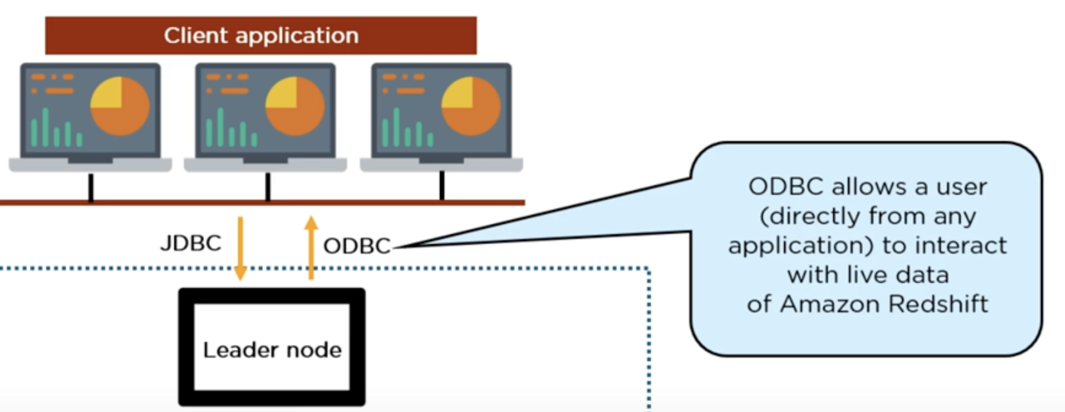
0. Inntroduction – Amazon Redshift– Architecture - JDBC / ODBC Driver

Slide 10
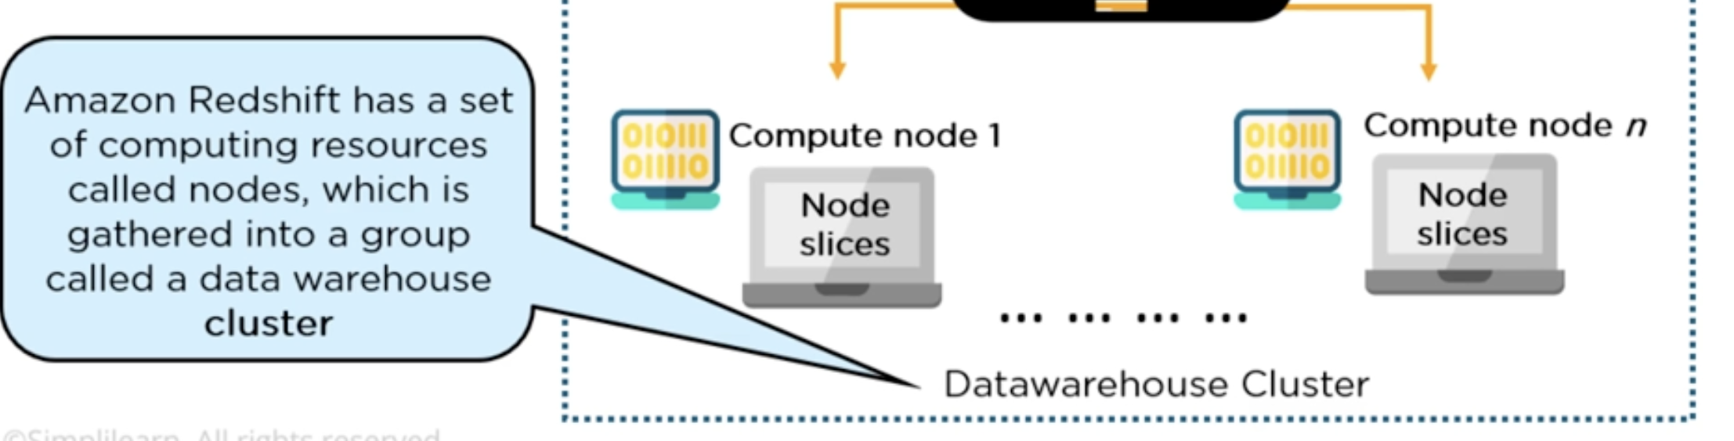
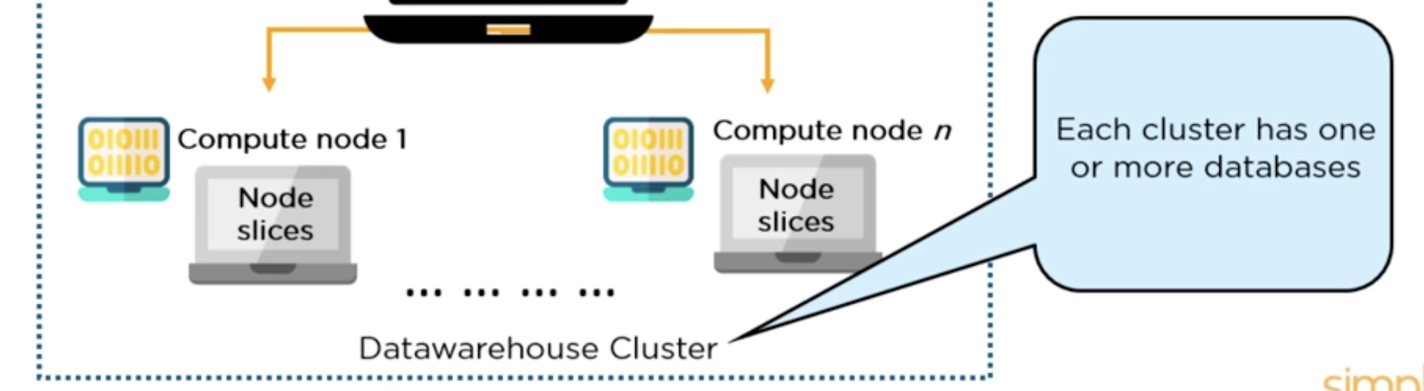
0. Inntroduction – Amazon Redshift– Architecture - cluster

Slide 11
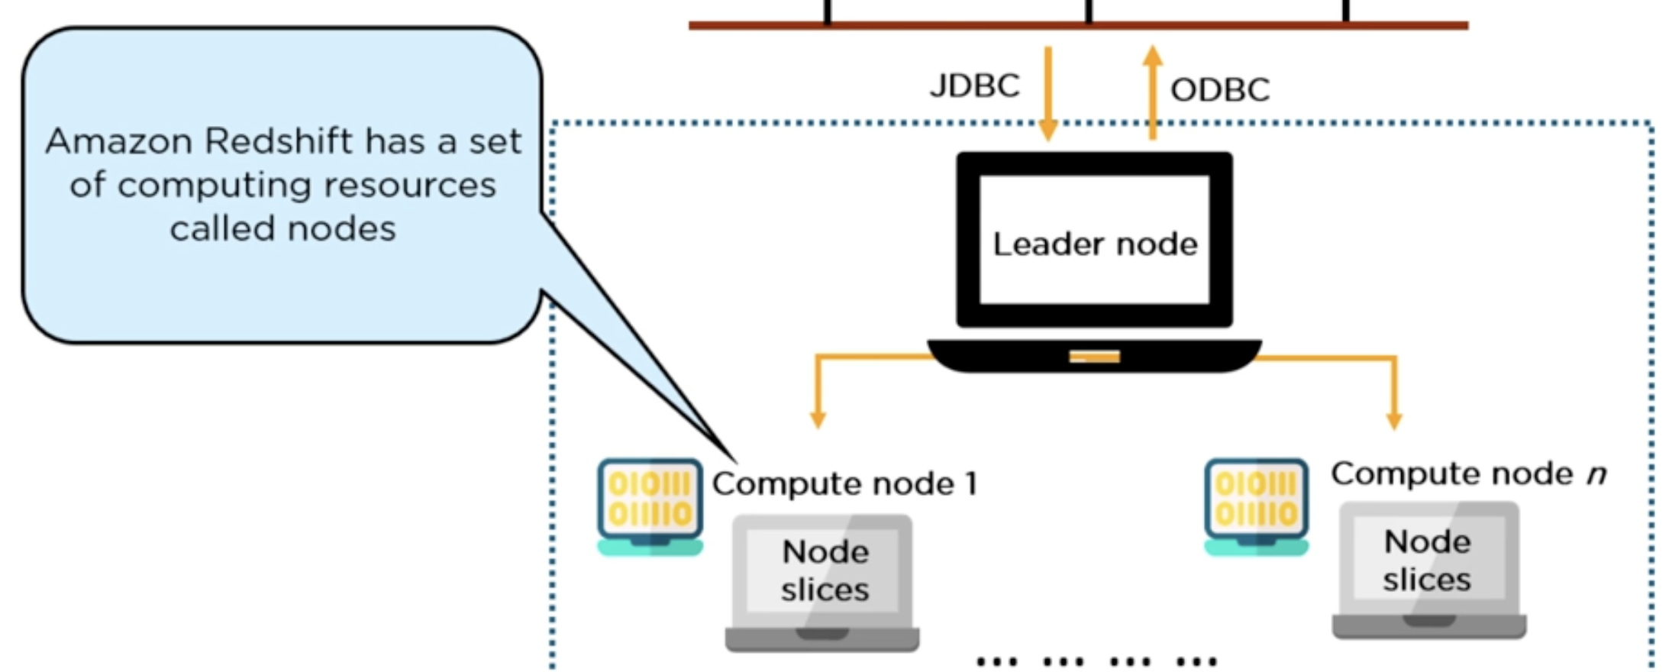
0. Inntroduction – Amazon Redshift– Architecture - nodes
Have 3 types of nodes:
Leader node.
Compute node.
Node slices

Slide 12
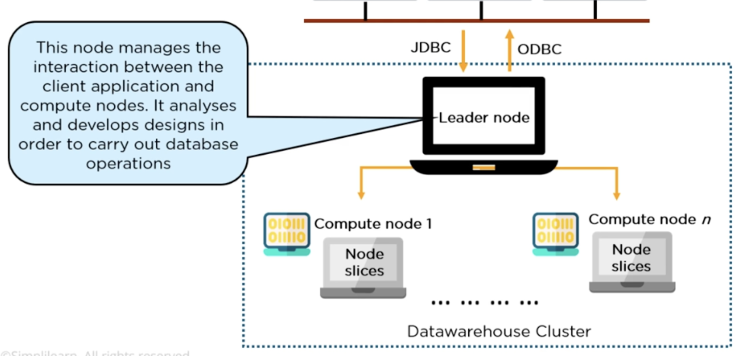
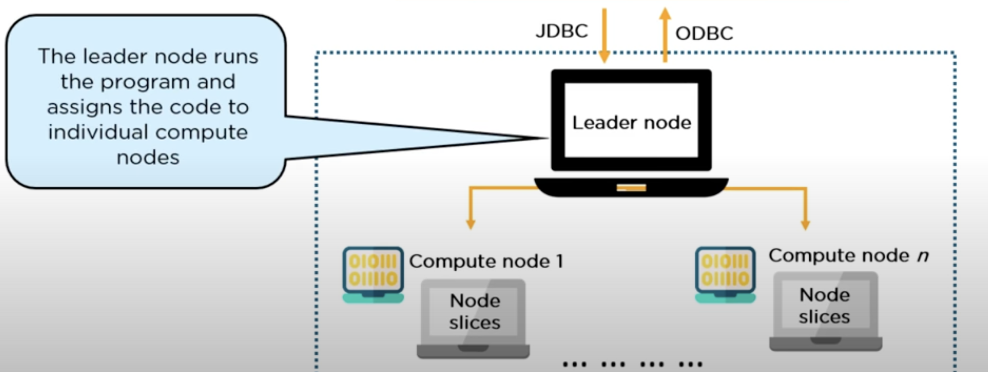
0. Inntroduction – Amazon Redshift– Architecture - leader node

Slide 13
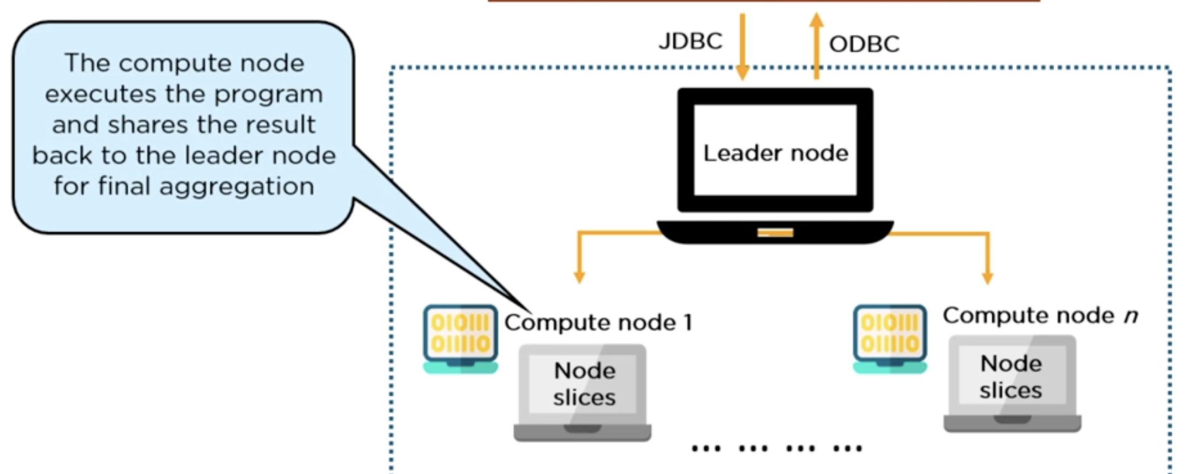
0. Inntroduction – Amazon Redshift– Architecture - compute node

Slide 14
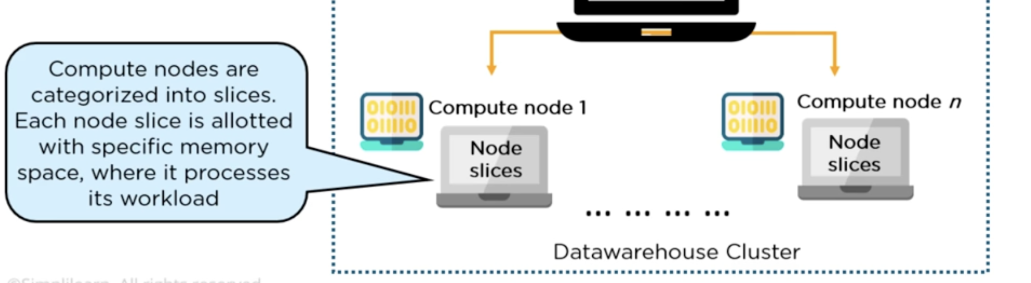
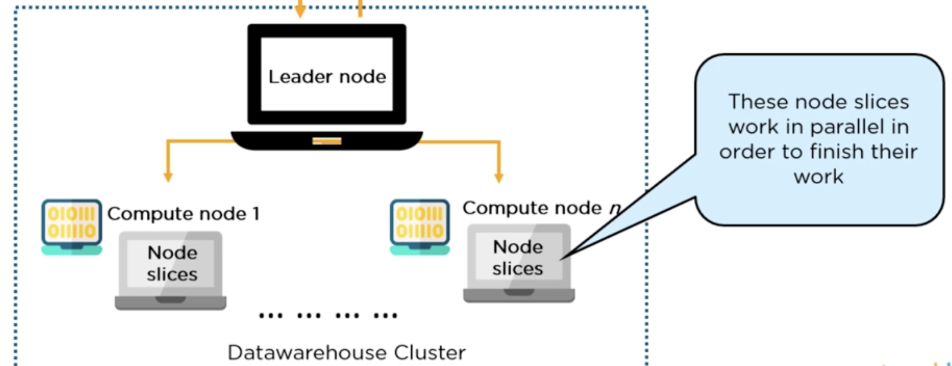
0. Inntroduction – Amazon Redshift– Architecture - node slide

Slide 15
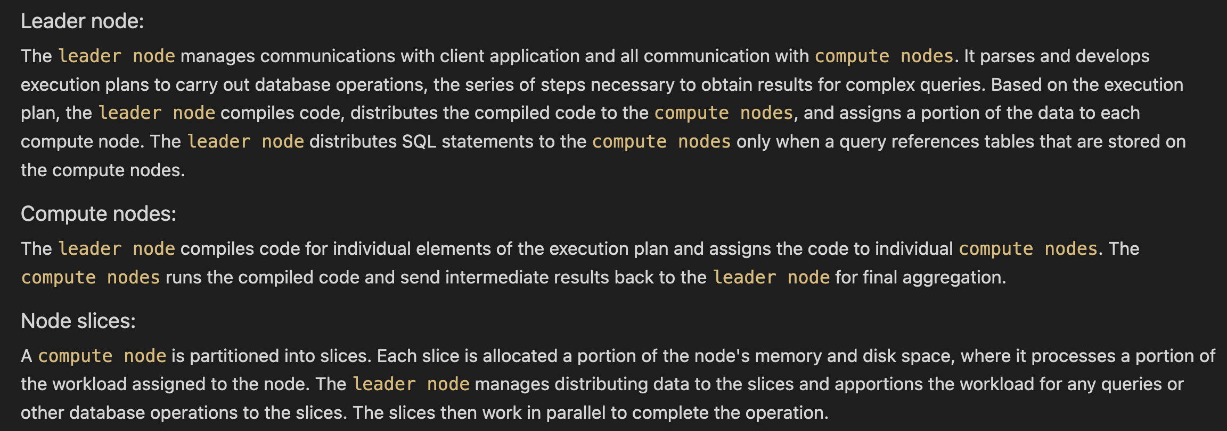
0. Inntroduction – Amazon Redshift – Architecture - Summary 3 types of node

Slide 16
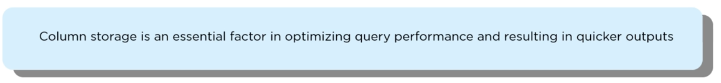
0. Inntroduction – Amazon Redshift – Column storage
Columnar storage for database tables is an important factor in optimizing analytic query performance because it drastically reduces the overall disk I/O requirements and reduces the amount of data you need to load from disk.

Slide 17
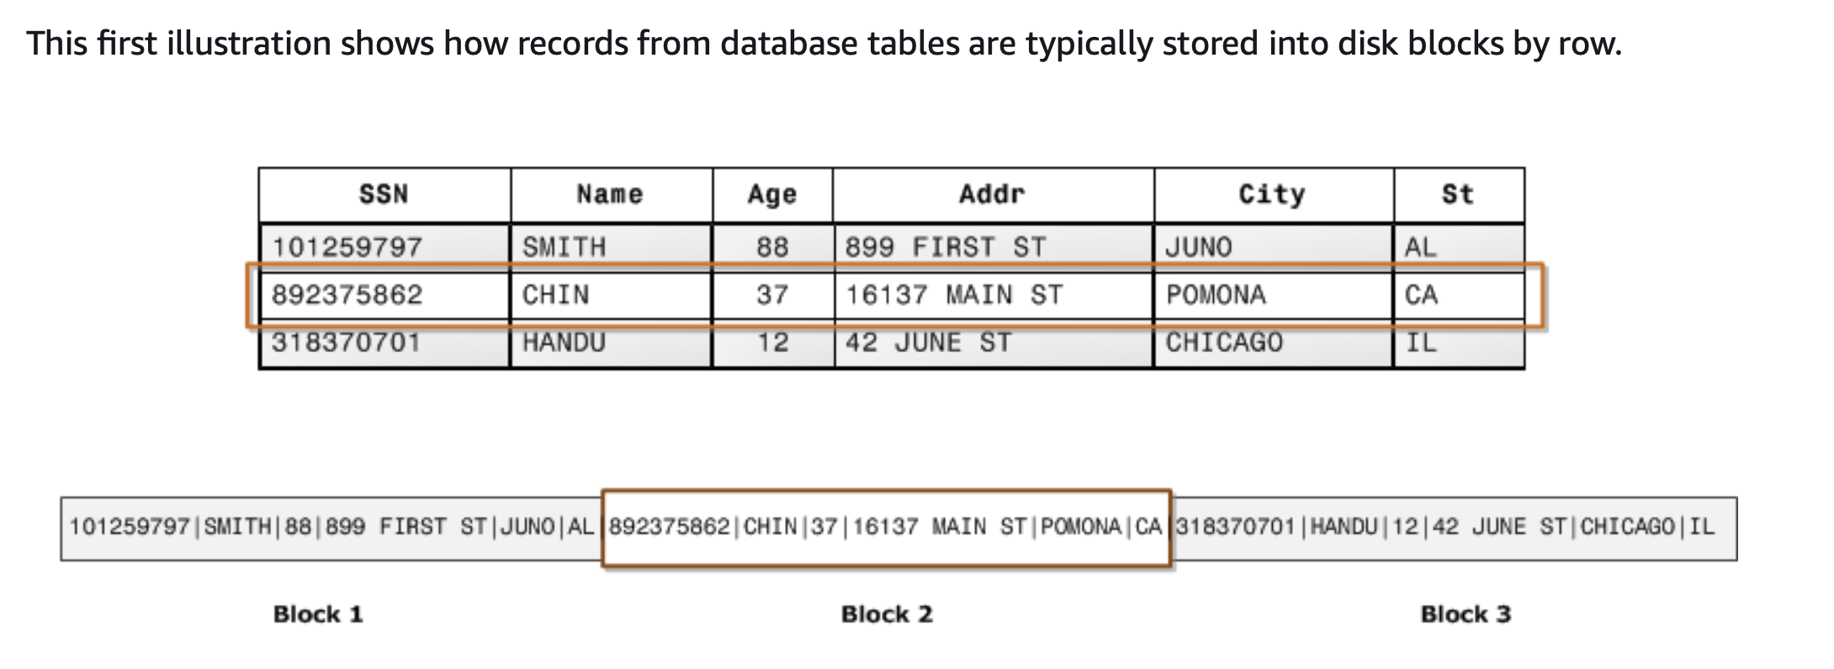
0. Inntroduction – Amazon Redshift – Columnar storage – Compare with row-wise storage
Row-wise storage
row-wise storage is optimal for online transaction processing (OLTP) databases cause In OLTP applications, most transactions involve frequently reading and writing all of the values for entire records, typically one record or a small number of records at a time.
Each row contains field values for a single record. In row-wise database storage, data blocks store values sequentially for each consecutive column making up the entire row. If block size is smaller than the size of a record, storage for an entire record may take more than one block. If block size is larger than the size of a record, storage for an entire record may take less than one block, resulting in an inefficient use of disk space.

Slide 18
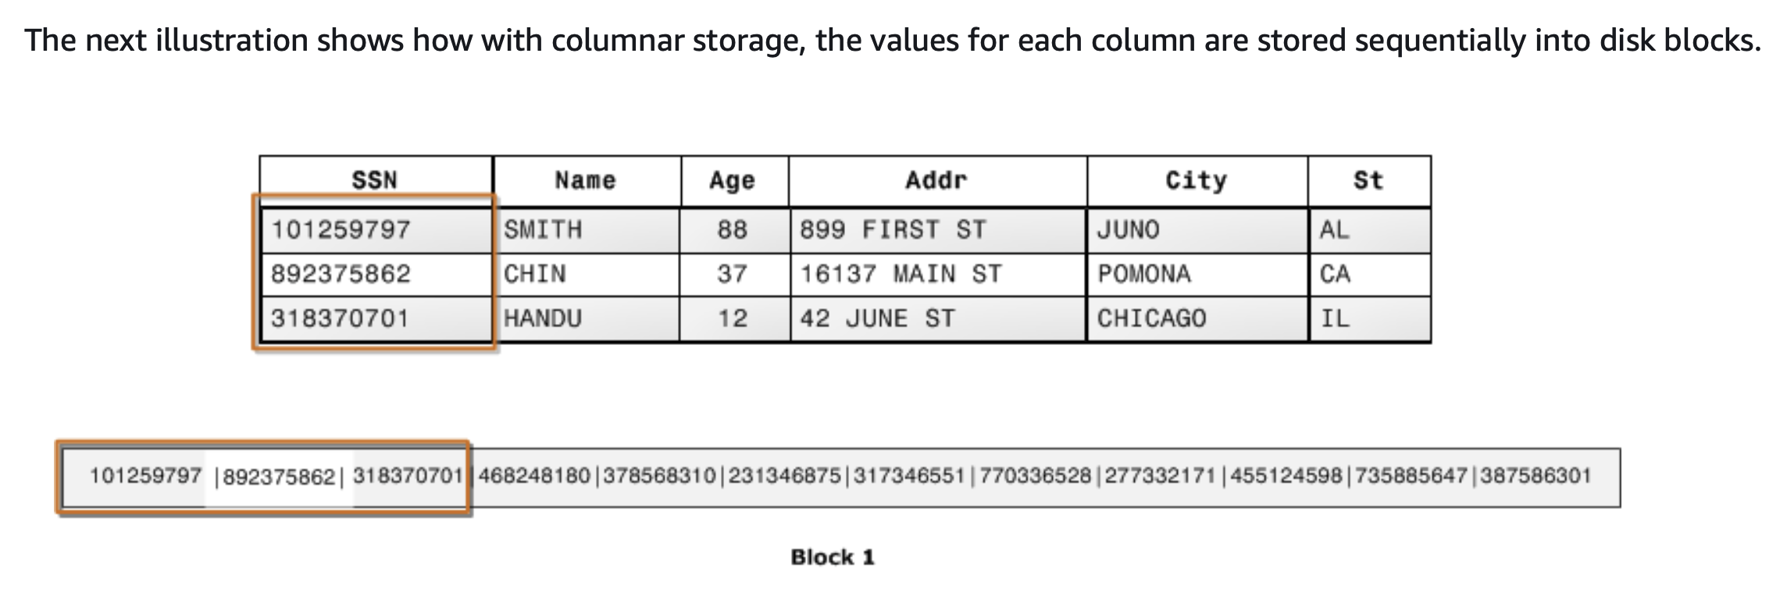
0. Inntroduction – Amazon Redshift – Columnar storage – Compare with row-wise storage
Column storage
Using columnar storage, each data block stores values of a single column for multiple rows. As records enter the system, Amazon Redshift transparently converts the data to columnar storage for each of the columns. In this simplified example, using columnar storage, each data block holds column field values for as many as three times as many records as row-based storage. This means that reading the same number of column field values for the same number of records requires a third of the I/O operations compared to row-wise storage. In practice, using tables with very large numbers of columns and very large row counts, storage efficiency is even greater.

Slide 19
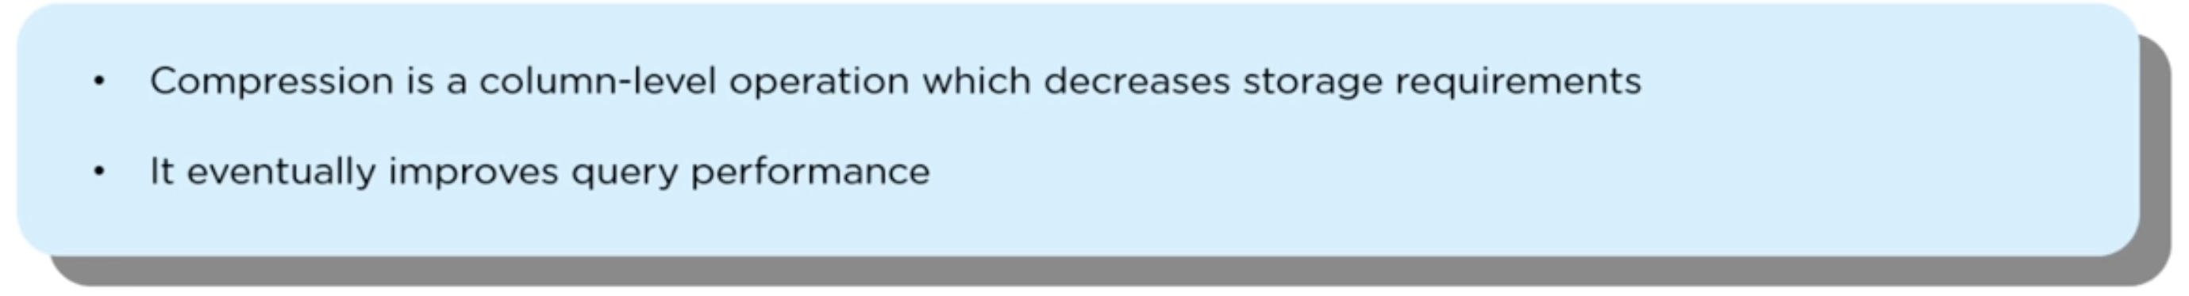
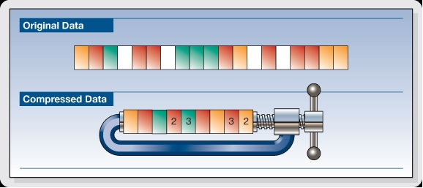
0. Inntroduction – Amazon Redshift – compression
Database compression is a set of techniques that reorganizes database content to save on physical storage space and improve performance speeds.
Compression can be achieved in two primary ways:
Lossless: Original data can be fully reconstructed from the compressed data.
Lossy: Reduction in data size due to deliberate compromise in quality.

Slide 20
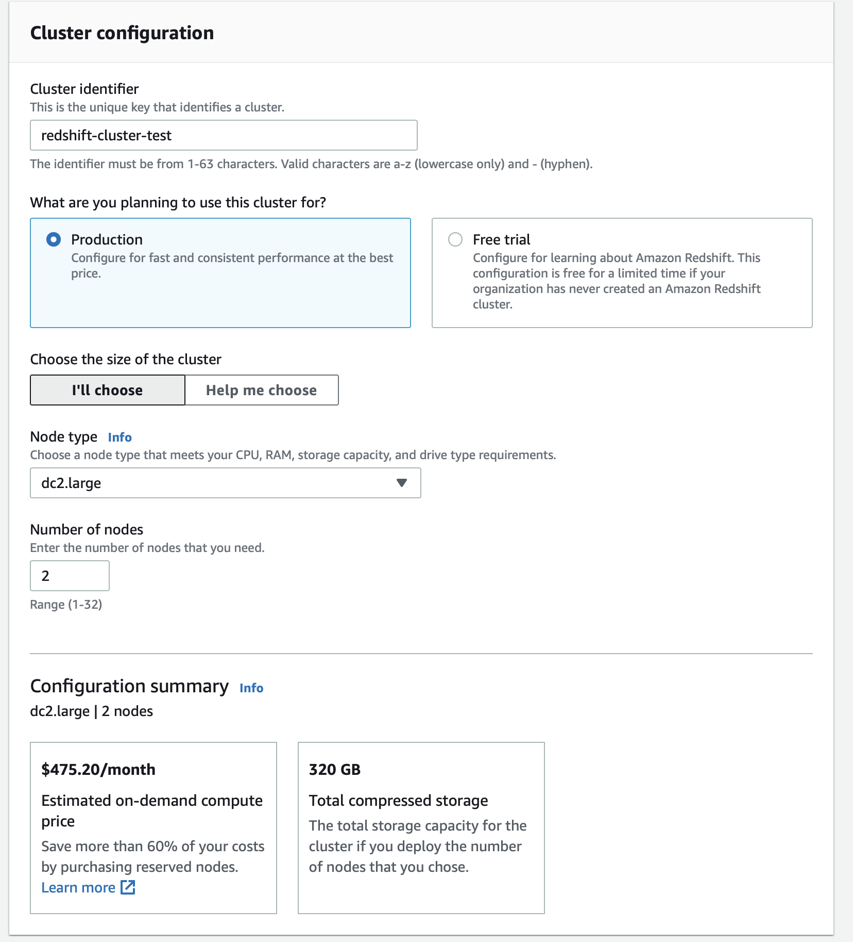
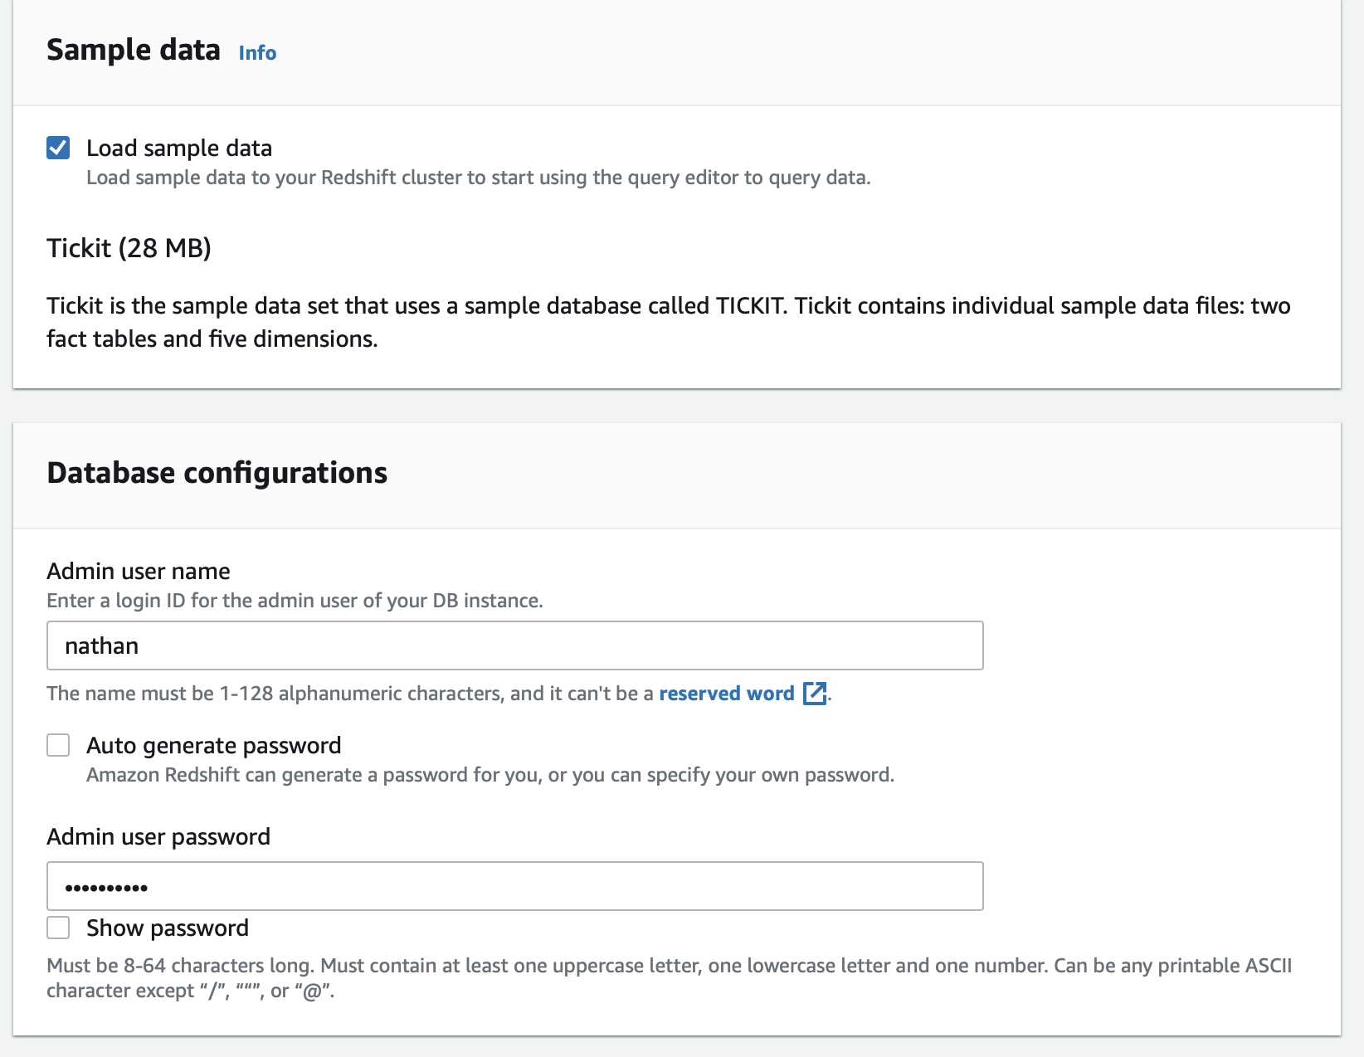
1. Getting start – Lab - Create new cluster in Amazon Redshift

Slide 21
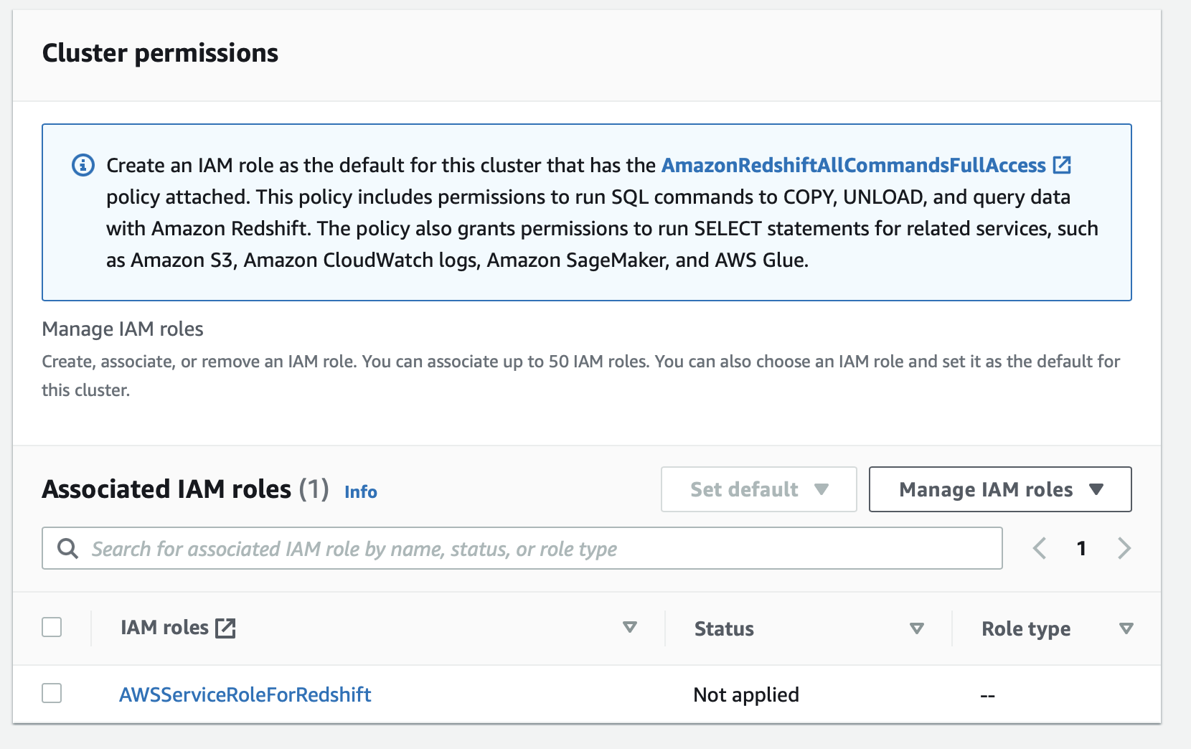
1. Getting start – Create new cluster in Amazon Redshift
Click Create cluster

Slide 22
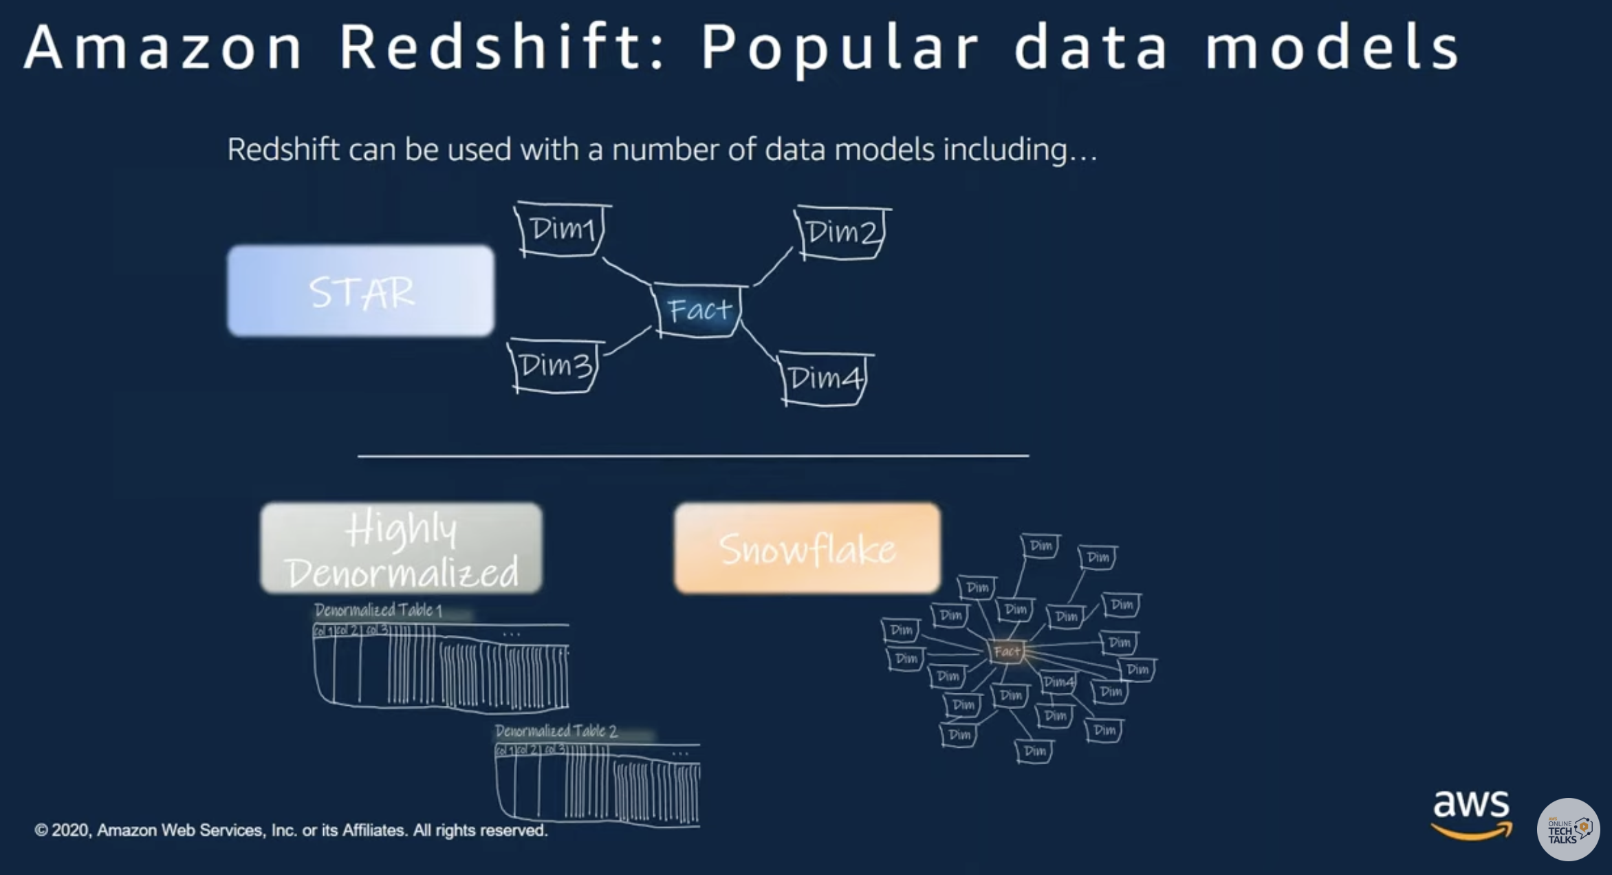
2. Data Modeling / Data type - Data Modeling in Amazon Redshift

Slide 23
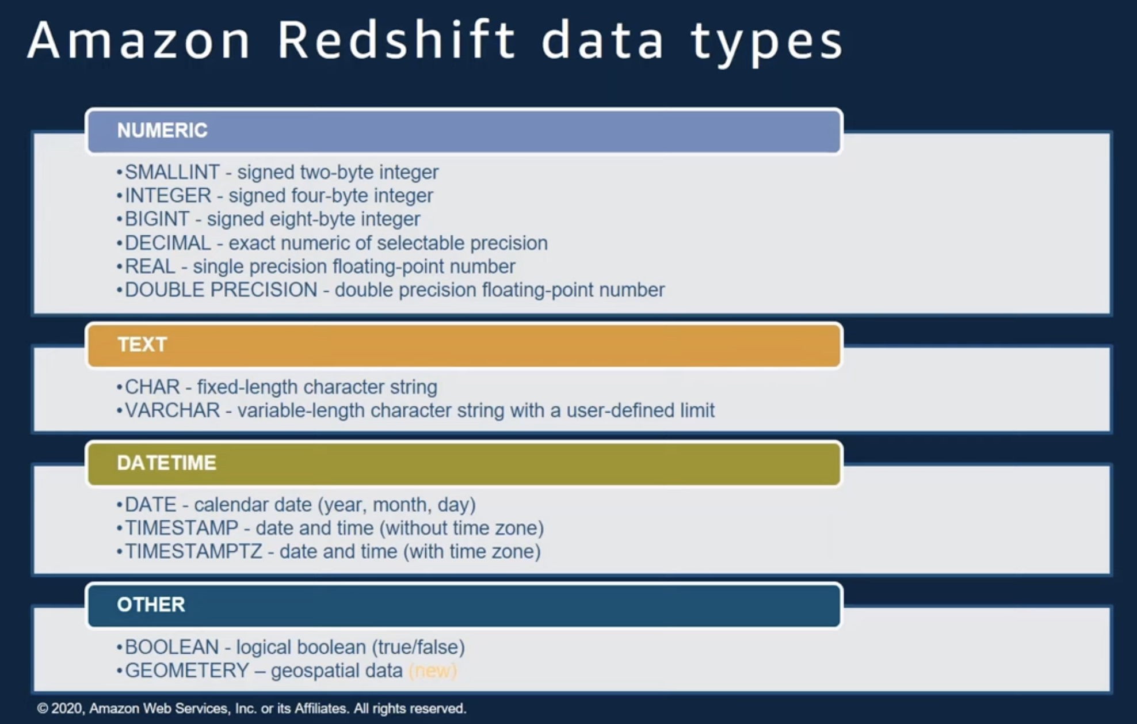
2. Data Modeling / Data type – Data type in Amazon Redshift

